Slide 1
CONSTRAINTS ON REALTION
BY: Dr. PARUL MADAN(AP)
CSE(GEU)
https://youtu.be/BGfE9PaMJD4

Slide 2
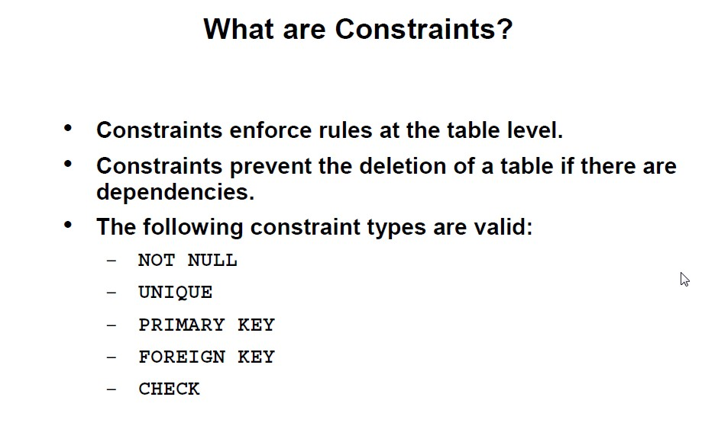
For Reference:
https://youtu.be/BGfE9PaMJD4 by Dr. Parul Madan

Slide 3
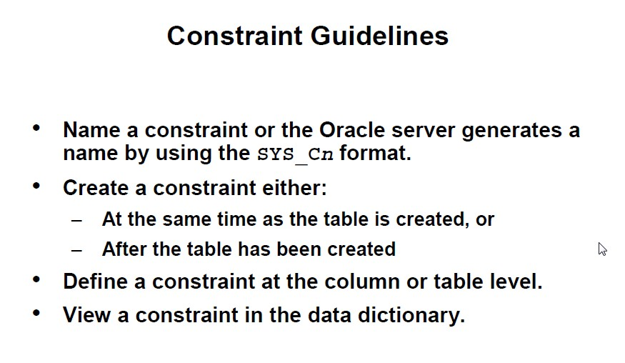
For Reference:
https://youtu.be/BGfE9PaMJD4 by Parul Madan

Slide 4
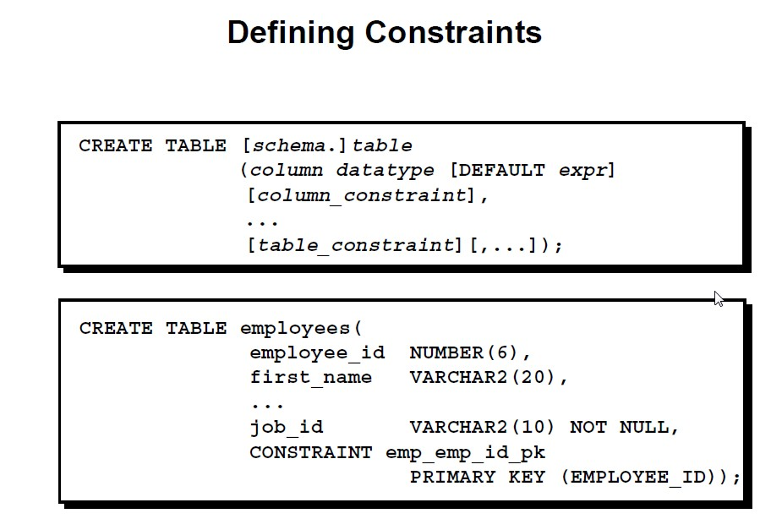
For Reference:
https://youtu.be/BGfE9PaMJD4 by Parul Madan

Slide 5
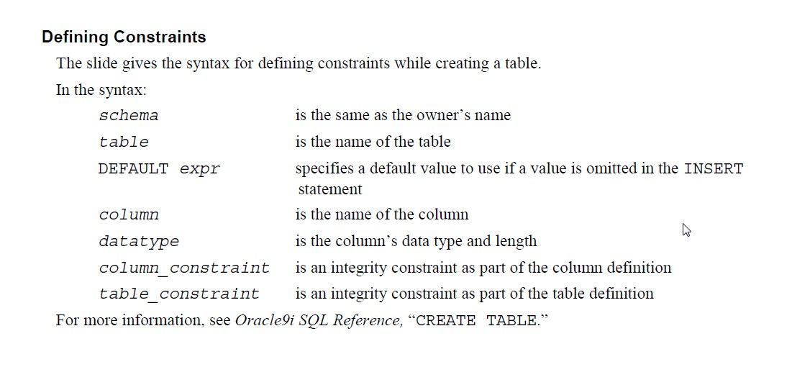
For Reference:
https://youtu.be/BGfE9PaMJD4 by Parul Madan

Slide 6
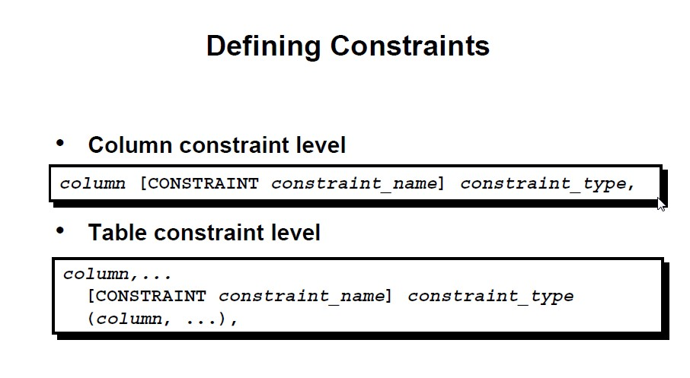
For Reference:
https://youtu.be/BGfE9PaMJD4 by Parul Madan

Slide 7
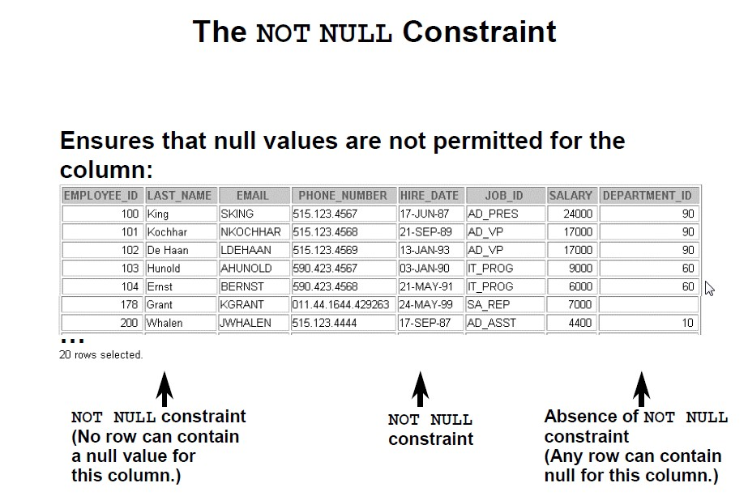
For Reference:
https://youtu.be/BGfE9PaMJD4 by Parul Madan

Slide 8
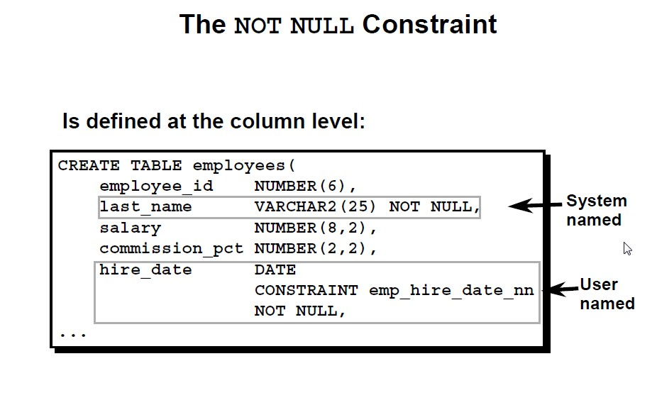
For Reference:
https://youtu.be/BGfE9PaMJD4 by Parul Madan

Slide 9
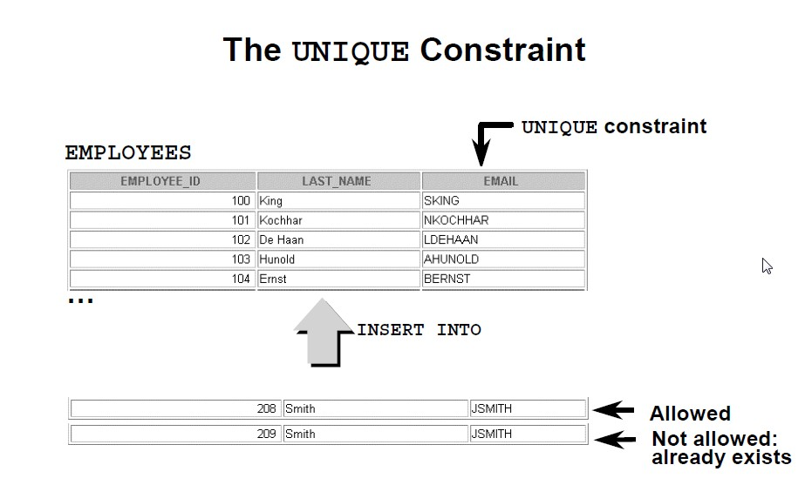
For Reference:
https://youtu.be/BGfE9PaMJD4 by Parul Madan

Slide 10
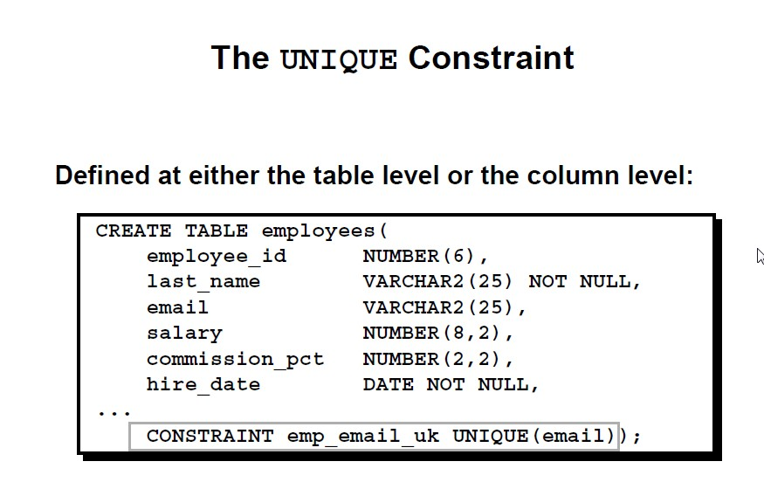
For Reference:
https://youtu.be/BGfE9PaMJD4 by Parul Madan

Slide 11
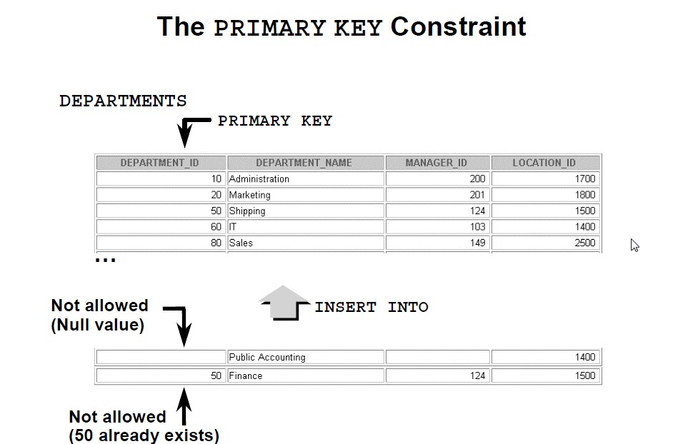
For Reference:
https://youtu.be/BGfE9PaMJD4 by Parul Madan

Slide 12
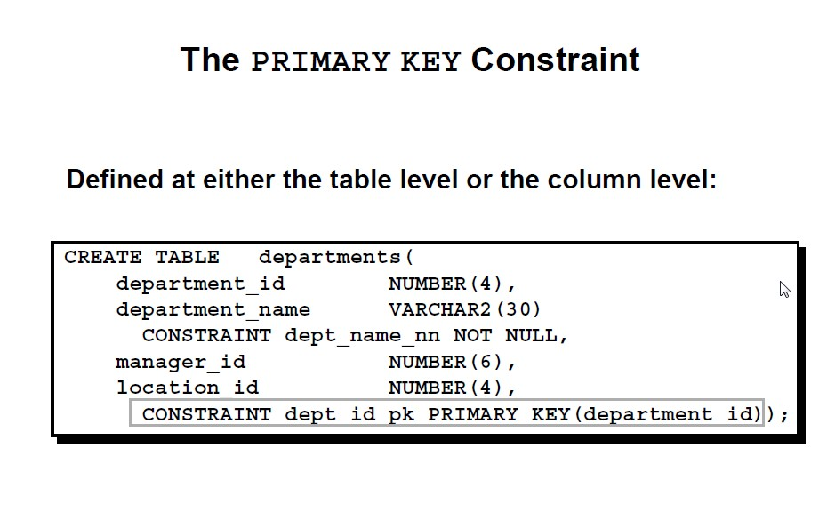
For Reference:
https://youtu.be/BGfE9PaMJD4 by Parul Madan

Slide 13
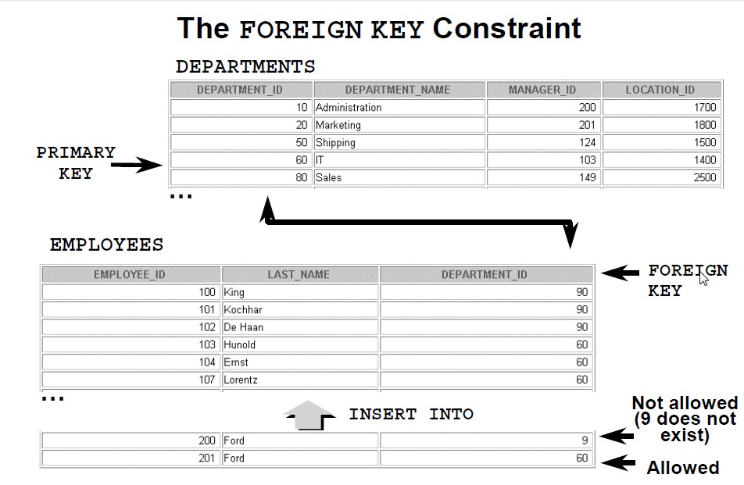
For Reference:
https://youtu.be/BGfE9PaMJD4 by Parul Madan

Slide 14
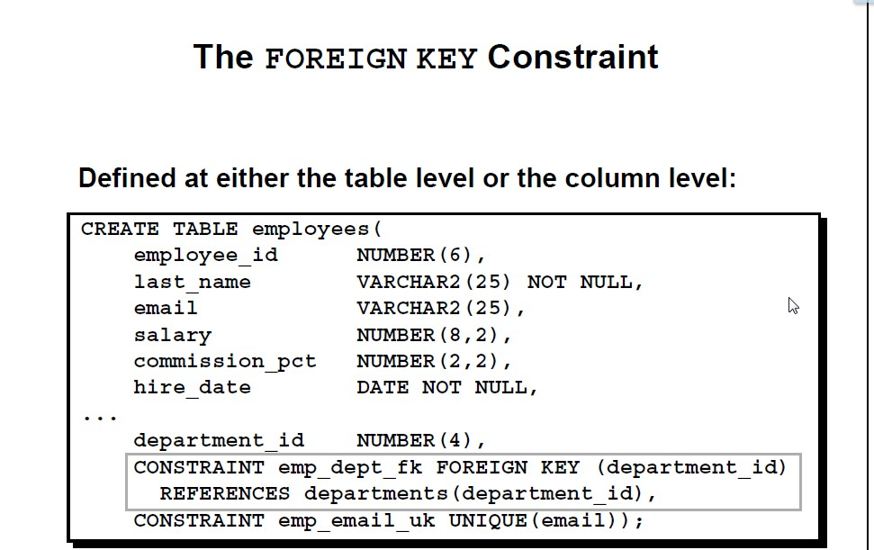
For Reference:
https://youtu.be/BGfE9PaMJD4 by Parul Madan

Slide 15
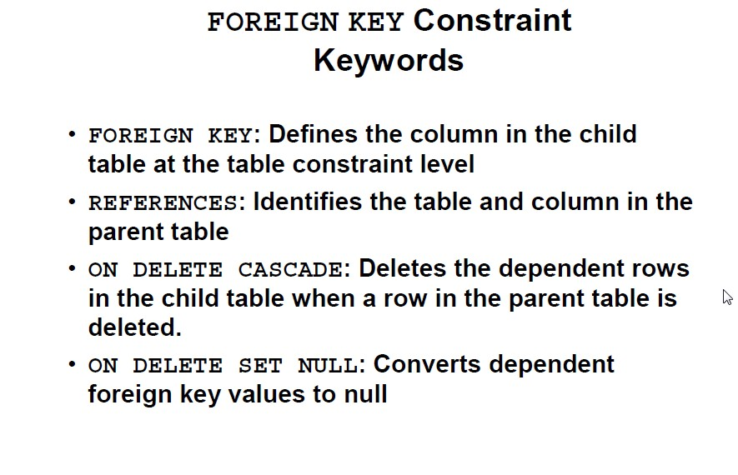
For Reference:
https://youtu.be/BGfE9PaMJD4 by Parul Madan

Slide 16
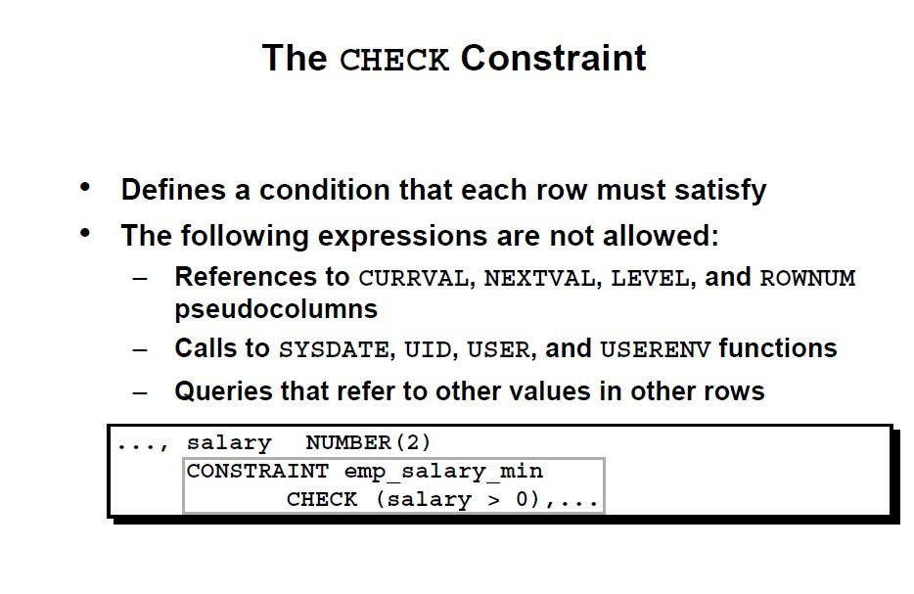
For Reference:
https://youtu.be/BGfE9PaMJD4 by Parul Madan

Slide 17
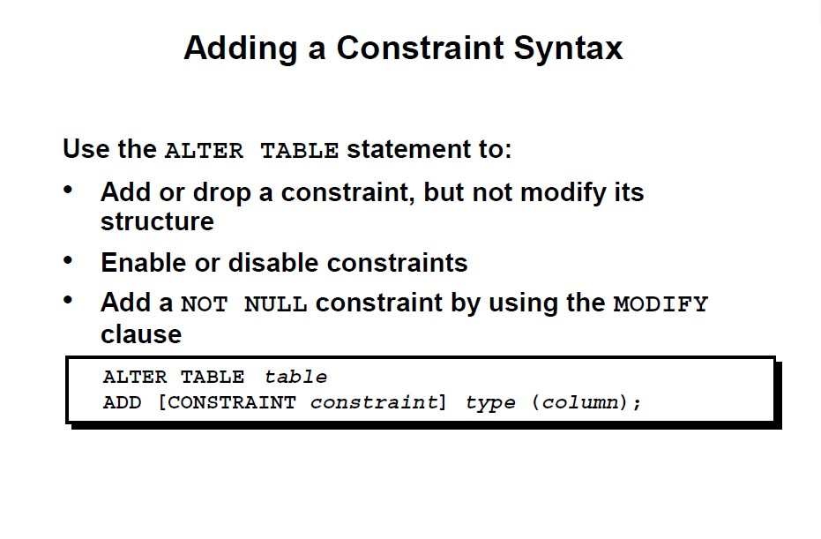
For Reference:
https://youtu.be/BGfE9PaMJD4 by Parul Madan

Slide 18
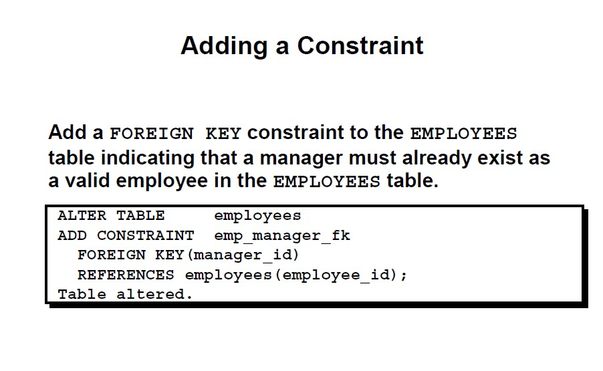
For Reference:
https://youtu.be/BGfE9PaMJD4 by Parul Madan

Slide 19
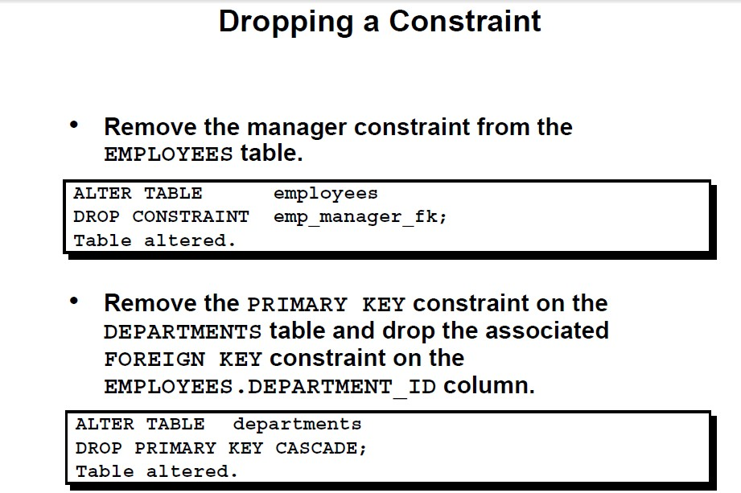
For Reference:
https://youtu.be/BGfE9PaMJD4 by Parul Madan

Slide 20
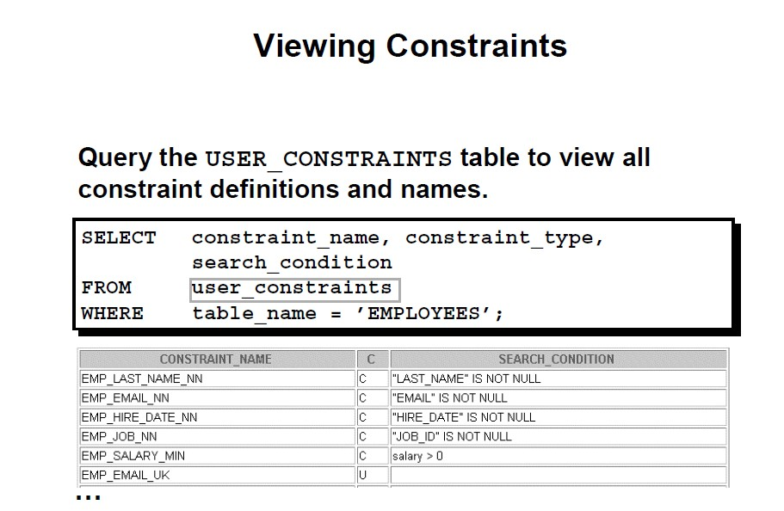
For Reference:
https://youtu.be/BGfE9PaMJD4 by Parul Madan

Slide 21
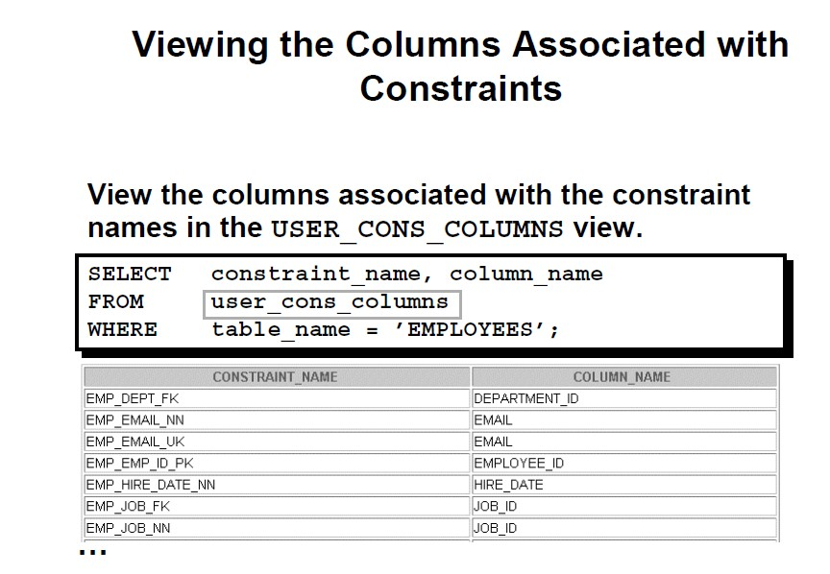
For Reference:
https://youtu.be/BGfE9PaMJD4 by Parul Madan

